Slide 1



Saidika
Your Mental Health Friend
a SAIDIKA strategic initiative
Group 12 ,
January 2024

Slide 2

About the project
PROJECT SUMMARY
Mental health is the cornerstone of well-being and is currently facing unprecedented challenges globally.
The demand for mental health services is on the rise, particularly among urban youth grappling with unique stressors.
According to WHO, there has been a 13% increase in mental health issues over the last decade.
This alarming statistic highlights the urgency of addressing mental health issues

Slide 3
Problem Statement
Saidika's mental health platform is challenged by the volume of clients, which hinders the timely allocation of therapy resources, especially for urgent cases.
Barriers (stigma, limited access to resources, and fear of judgment) many people struggle to seek the support they desperately need.

Slide 4

PROPOSED SOLUTION
Main Objective is to integrate an advanced AI-powered mental health chatbot into Saidika's existing platform to optimize client management processes, ensuring timely and appropriate allocation of therapy resources to those in need.

Slide 5
specific objectives
Companion Chatbot:
Your go-to friend, available 24/7 for a chat anytime, even at 3 AM.
Offers a supportive presence whenever you need someone to talk to.
Efficient Multitasking:
Ultimate multitasker handling routine inquiries efficiently.
Frees up therapists to focus on providing quality care.
Long-Term Insight:
Beyond immediate problem-solving; it's about riding the tsunami of data.
Collects and analyzes interactions, providing insights for continuous improvement.
Quality Care Focus:
Enables therapists to concentrate on what they do best – delivering quality care.
Enhances overall service effectiveness through smart task delegation.
Continuous Improvement:
Ensures Saidika stays on the right course by steering with valuable insights.
A commitment to evolve and improve based on collected data and user interactions.

Slide 6

Impact of our project
our project isn't just about technology. It's about transforming Saidika's services, making them not just scalable but compassionate. We're not just streamlining operations; we're building a lifeline for those seeking mental health assistance.

Slide 7

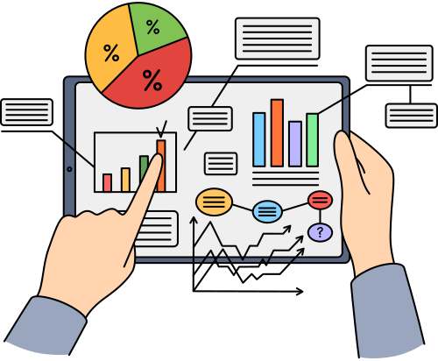
Data
Data Source
Data was scraped from public domain resources
Health forums
Reddit
Mental health forum
Beyond blue
Data preparation
Variable Types: Categorical variables for types of mental health issues, binary variables for urgency, and continuous variables for sentiment scores.
Preprocessing Steps: Text data was cleaned of any identifiable information, tokenized, lemmatized, and vectorized for NLP processing.

Slide 8

Data
preprocessing steps
Text data cleaning: Removal of identifiable information.
Tokenization: Breaking down text into tokens.
Lemmatization: Reducing words to their base or root form.
Vectorization: Converting text into numerical vectors suitable for Natural Language Processing (NLP) tasks.

Slide 9

Tools
Libraries
BeautifulSoup
Python Libraries - NLTK, spaCy for NLP tasks,
Algorithms
Logistic regression
LSTM
BERT
GPT
PLATFORM
Kaggle
Local
Colab

Slide 10
EDA
Distribution & Frequency analysis
Subreddit distribution
Word analysis (Most common words, word cloud visualisation)
text & sentiment analysis
Text matrix (Average sentence length, text length, word count)
Sentiment analysis (Distribution of sentiments, analysing average polarity for each sentiment)
text complexity & correlation analysis
Text complexity (Readability scores to assess text complexity)
Correlation matrix (Exploring interrelationships among features)

Slide 11
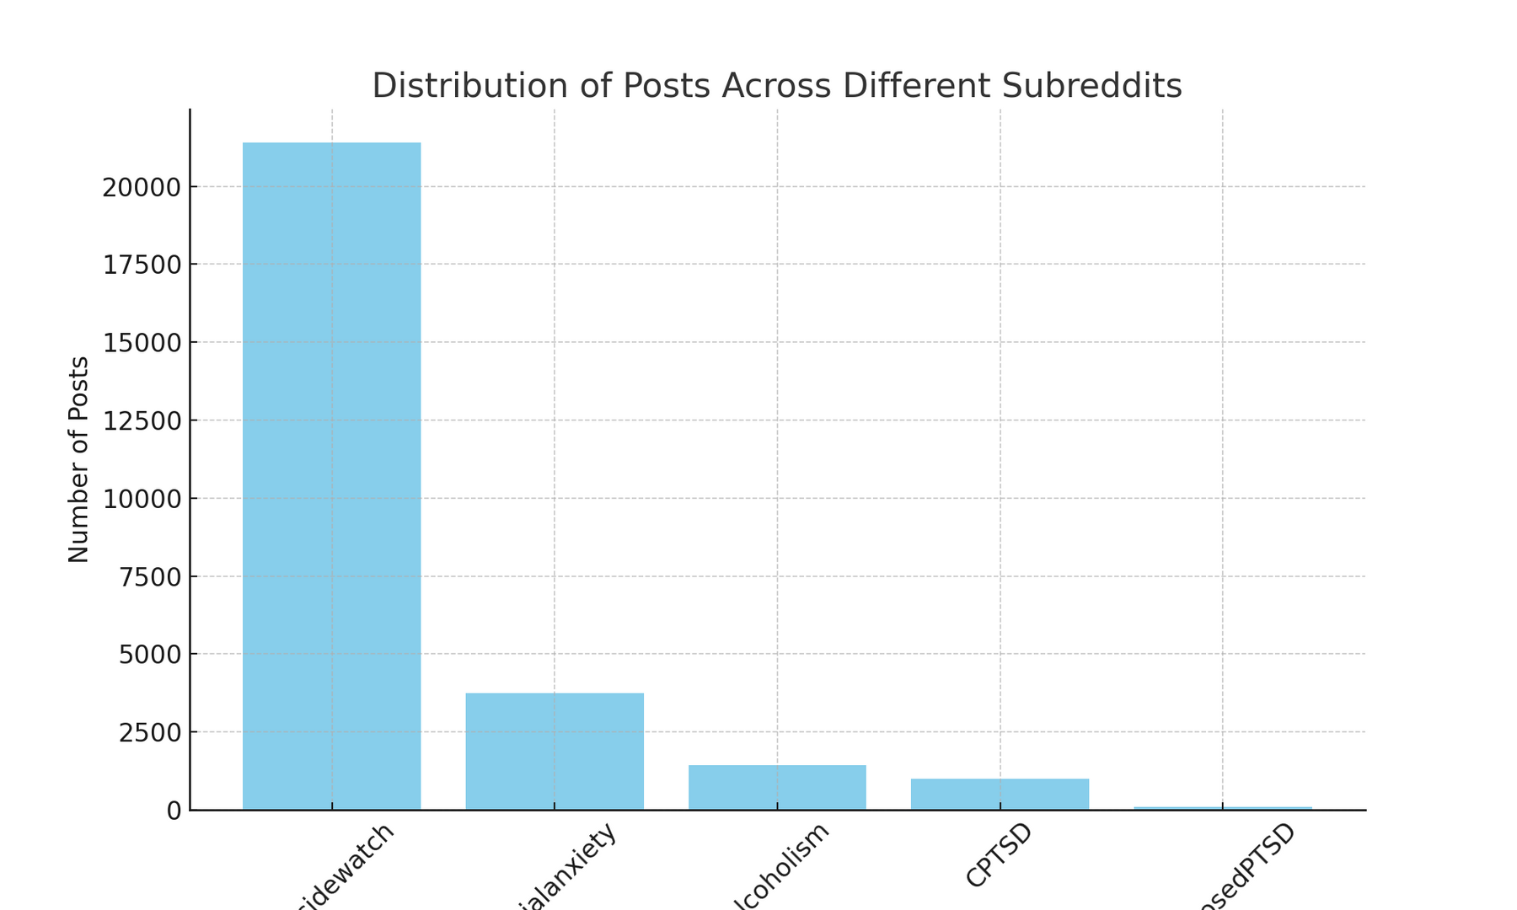
Distribution & Frequency Analysis

Slide 12
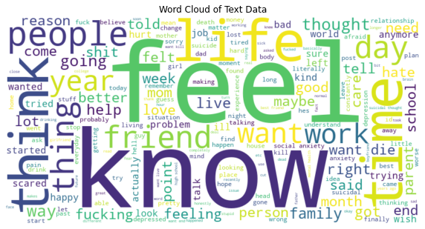
Distribution & Frequency Analysis

Slide 13
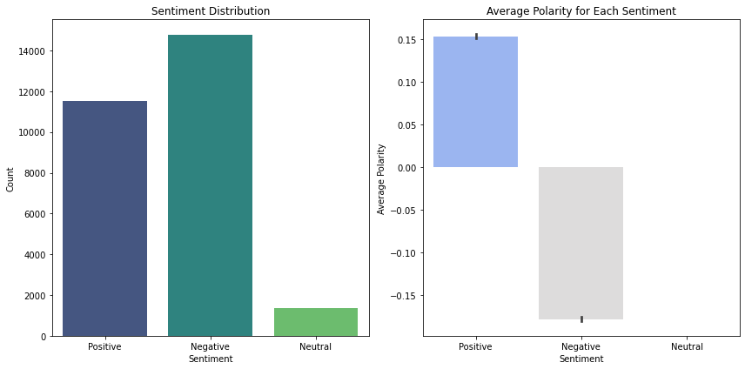
Sentiment Analysis

Slide 14
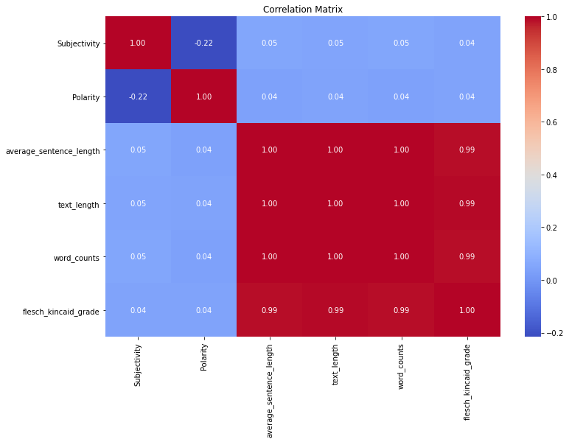
Correlation Analysis

Slide 15

MODELLING
In this section, we used the machine learning classification algoithms specified in the introduction to classify a user's input into one of our specified categories/classes:
CPTSD
alcoholism
diagnosedPTSD
socialanxiety
suicidewatch

Slide 16
MODELS USED
Multinomial Naive Bayes Classifier
Random Forest Classifier
SGD Classifier
Improved recall in ‘alcoholism’ & ‘diagnosedPTSD’ but still low for others.
High precision across most categories.
Better F1 scores.
Overall accuracy: 88%
K Nearest Neighbour (KNN)
High recall and precision for ‘suicidewatch’ & lower for other categories.
F1 score strong for ‘sucidewatch’ but needs improvement in other categories.
Overall accuracy: 77%
Improved recall & high precision for ‘alcoholism’ & ‘socialanxiety’
Better F1 scores
Overall accuracy: 87%
High precision across all categories.
Moderate F1 scores
Overall accuracy: 88%

Slide 17

DEFINING METRICS
The cost of errors and the uneven distribution in the number of posts in our subreddits make it important to carefully define the metrics. The class imbalance makes accuracy unsuitable for use in this case.
Considering this is a mental health issue, it will be very important for us to identify suicide cases as suicide. This category has the highest cost of error as someone's life could be on the line.

Slide 18

Methodology
Modelling, evaluation, deployment.
Modelling
Identify main intents of users: - Seeking advice, expressing feelings
Identify entities - Specifical mental health conditions
Train models (GPT, Pytorch)
Conversational flow - Dialogflow
Evaluation
Metrics: We will use a combination of traditional classification metrics and specific metrics pertinent to the mental health domain to ensure robust evaluation.
MVP: The MVP will be a working chatbot capable of categorizing mental health issues into urgent and non-urgent with basic accuracy.
Deployment
Deployment Plan: The chatbot will be deployed on Saidika's web and mobile platforms, with an intuitive user interface for both clients and therapists.
Ethics to be considered

Slide 19
Limitations
Data Scraping Challenges:
Scraping data on mental health issues proved to be an overwhelming task due to the vast and complex nature of the topic.
To manage this, we consulted with a mental health specialist who advised us to narrow down our focus to specific categories: CPTSD, alcoholism, diagnosedPTSD, socialanxiety, and suicidewatch.
This limitation meant that our dataset might not have captured the full spectrum of mental health discussions online, potentially leading to biases or gaps in our model's understanding.
Deployment Challenges with Dialogue Flow:
The deployment stage, particularly integrating dialogue flow for user interaction, was challenging.
The vastness and sensitivity of mental health issues made it difficult to design responses that are both appropriate and contextually accurate.
Ensuring that the chatbot's responses were sensitive, informative, and helpful without being misleading or harmful required careful consideration and nuanced understanding.

Slide 20
Recommendations
1. Expanding Data Collection:
To address the limitation in data scope, future iterations of the project could include a wider range of mental health topics.
Collaborating with more mental health professionals could provide insights into additional relevant categories and help in gathering a more comprehensive dataset.
2. Enhancing Dialogue Flow:
To improve the chatbot's performance in handling sensitive conversations, it is recommended to integrate advanced NLP techniques that can better understand user sentiment and context.
Regular updates and reviews of the dialogue scripts by mental health professionals can ensure that the chatbot remains sensitive and accurate in its responses.

Slide 21
Recommendations
3. Continuous Model Evaluation and Tuning:
Given the evolving nature of online discussions and language use, it's crucial to regularly evaluate and update the classification models to maintain their accuracy and relevance.
Implementing feedback loops where users can report inaccuracies or suggest improvements can also be valuable.
4 . Addressing Class Imbalance:
Further research into techniques for handling class imbalance in machine learning models can improve the model's performance, especially in underrepresented categories.
5. Ethical Considerations and User Safety:
Given the sensitivity of mental health issues, it's important to prioritize ethical considerations and user safety in all aspects of the project.
Establishing clear guidelines and safeguards to protect users, especially in scenarios where the model might fail or misclassify inputs, is essential.

Slide 22


Thank you
MARYAN
BUSHRA
DOMINIC
ALEX
ANGELLA
DENNIS
JULIET

